Slide 1
Basic or Advanced and Scientific Calculator Using Python Tinkter
NextHikes IT Solutions – Project 2
Developed By: Rashika Singh
GUI-based calculator using Python, Tkinter and Math Module

Slide 2
Project Overview and Problem Statement
Performs Basic, Advanced and Scientific calculations
User-friendly graphical interface
Real-time calculation and result display
Designed for learning GUI development

Slide 3
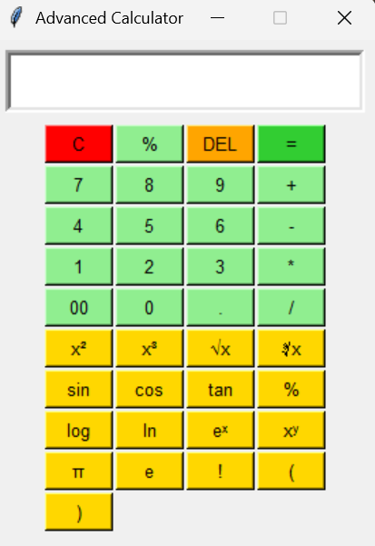
Why My Calculator is Unique
3-in-1 Calculator (Basic + Advanced + Scientific)
Scientific functions: sin, cos, tan, log, sqrt
Smart error handling
Displays:
Cannot divide by zero
Error
GUI-Based Interface
Easy Navigation
Button-Based Inputs
Interactive Display Screen

Slide 4
Development Tools
Python Programming Language
Tkinter for GUI
Math Module for scientific calculations
VS Code
Coding
Debugging
Project Development

Slide 5
Code Architecture and Workflow
Project Workflow
Core Functions
Function | Purpose
press() | Capture Input
calculate() | Evaluate Expression
clear() | Reset Calculator
sin_func() | Sine Calculation
cos_func() | Cosine Calculation
tan_func() | Tangent Calculation
sqrt_func() | Square Root
log_func() | Logarithm
User Input
↓
Button Click Event
↓
Expression Processing
↓
Scientific Calculation
↓
Result Display

Slide 6
Results & Output
Arithmetic calculations
Trigonometric calculations (sin(), cos(), tan(), log(), √)
Logarithm and square root operations
Accurate and fast outputs
Why My Calculator is Better
Combines Basic + Scientific Functions
Handles Errors Gracefully
Easy-to-Use GUI
More Features than a Basic Calculator
Easy to Extend with New Functions

Slide 7
Learning Outcomes, Conclusion
Core Python Programming
Functions
Variables
Exception Handling
Tkinter GUI Development
GUI Development
Event Handling
Successfully developed a professional GUI-based Advanced and Scientific Calculator capable of performing both arithmetic and scientific operations efficiently.

Slide 8
References
Python Official Documentation
Used for Python programming concepts and syntax
Tkinter Documentation
Used for GUI development (buttons, frames, entry widgets).
Python Math Library
Used for scientific functions such as sin(), cos(), tan(), sqrt(), and log()
https://www.geeksforgeeks.org/html/html-scientific-calculator/
https://www.geeksforgeeks.org/python/scientific-gui-calculator-using-tkinter-in-python/

Slide 9
Thank you

